Slide 1
Project - 2
Aman agarwal
Dhanraj sahu
prashant
prahsant meena
Silky priya

Slide 2
Introduction
DDoS is short for Distributed Denial of Service. DDoS is a type of DOS attack where multiple compromised systems are used to target a single system causing a Denial of Service (DoS) attack.
A queue management algorithm is important to guarantee the fair distribution of resources and quality of service (QoS) in the event of network congestion
Examples - Drop-Tail, RED, and REM.

Slide 3
Queue Management Algorithms
The composition of a network is mainly based on the technology of store-and-forward and statistical multiplexing.
The important role of the queue in a router is to absorb unexpected packets.
Thus, we must manage the queue through the router to maintain a smaller queue length.

Slide 4
Types of queue management algorithms
Active Queue Management Algorithms - RED and REM.
Passive Queue Management Algorithms - DropTail.

Slide 5
Significance of Queue Management Algorithms
In contrast to passive queue management algorithms, active queue management algorithms discard packets before the queue is full to regulate the discharge velocity of the original transmission source.
This approach helps control congestion to avoid other negative effects such as long end-to-end delays caused by full queues and a reduction of the utilization ratio.

Slide 6
Passive Queue Management Algorithms
Set a maximum length for each queue (in packets) and then accept packets into the queue until the queue length limit is reached.
Thus, any subsequent packet that arrives will be rejected by the queue until the queue length has decrease.
Drop-Tail queue management mechanisms are still the most widely used method for queuing and discarding network packets.

Slide 7
RED Queue Management Algorithm
The RED queue management algorithm uses the average queue length to predict impending network congestion and drops packets using random selection.

Slide 8
REM Queue Management Algorithm
The random exponential marking (REM) algorithm management mechanism stems from “optimal flow control” theory.
Depends on the difference between the actual queue length and the expected queue length, and the other is the difference between the input rate of aggregated flow and the output rate of the port.
REM stabilizes the input rate to remain close to the link capacity and maintains the queue length within a small target range.

Slide 9
EXPERIMENT
Simulation of three Queue Management techniques – Tail Drop, RED and REM, for a mesh network.
The results obtained are analysed over 3 parameters: Throughput, End-2-End delay and Packet Loss/Drop.
RED and REM came out as a queue management technique with the target to outperform the performance of Tail Drop.

Slide 10
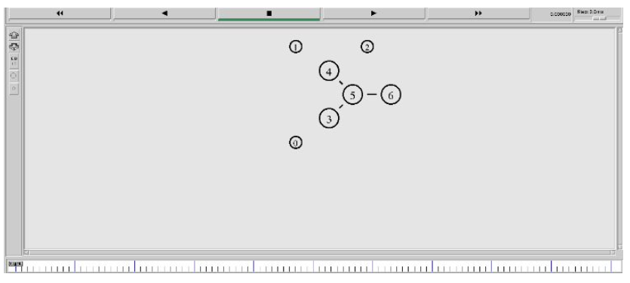
Network Topology and Simulation Scenario

Slide 11
CONCLUSION
The results showed that the active queue management algorithms, such as REM and RED, exhibited stronger capabilities than the passive queue management algorithm Drop-Tail.
under large-scale DDoS attacks, all three algorithms exhibited insufficient defense capabilities.

